Slide 1
Effect of exercise on Heart and Blood circulation
Presented
By
Dr. Subhas Chandra Nandi

Slide 2
Short term Physical activity Effects on Heart
Increase Heart rate (Pulse)
Increase Blood pressure

Slide 3
Long term High intensity Physical activity Effects on Heart
1. Bradycardia: Bradycardia is a slower than normal heart rate around 40-60 beats per minute.
2. Cardiomegaly : Cardiomegaly is the state of an enlarged heart.
3. Cardiac Hypertrophy : Cardiac Hypertrophy is the thickening of the muscular wall of the heart, specifically the left ventricle, which pump oxygenated blood to the aorta.
The wall of the left ventricle increases in size by about 15-20% of its normal capacity.
4. Stroke volume increase (Heart pumps more blood with each stroke)
5. Heart rate (pulse) returns to its “resting rate” more quickly after period of intense activity.
6. Risk of coronary artery disease is generally reduced, though this is also affected by other factors e.g. diet.

Slide 4
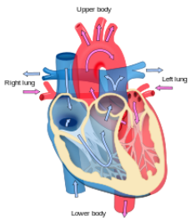
Short term Physical activity Effects on the blood circulation
More (a greater volume of) blood is pumped around the body.
Blood is diverted from the soft organs within the body into the blood vessels to be moved around the body.
The blood is transported (i.e. moves) heat from the active muscle to the surface of the body.
muscle heat body surface

Slide 5
Long term High intensity Physical activity Effects on the blood circulation
Quantity of Red blood cells increases improving the ability of the blood transport oxygen around the body.
Blood supply to the muscle fiber is improved by more capillaries becoming available to take blood to the muscle tissues.
Similarly efficiency of return of de-oxygenated blood to the heart is also improved.

